Slide 1
International Economics
Chapter 2: The Law of Comparative Advantage
Dominick Salvatore
John Wiley & Sons, Inc

Slide 2
Comparative Advantage and Opportunity Costs
Ricardo based his law of comparative advantage on a number of simplifying assumptions:
(1) only two nations and two commodities,
(2) free trade,
(3) perfect mobility of labor within each nation but immobility between the two nations,
(4) constant costs of production,
(5) no transportation costs,
(6) no technical change, and
(7) the labor theory of value.

Slide 3
Comparative Advantage and Opportunity Costs
Although assumptions one through six can easily be relaxed, assumption seven (i.e., that the labor theory of value holds) is not valid and should not be used for explaining comparative advantage.

Slide 4
Comparative Advantage and the Labor Theory of Value
Under the labor theory of value, the value or price of a commodity depends exclusively on the amount of labor going into the production of the commodity.
This implies
(1) that either labor is the only factor of production or labor is used in the same fixed proportion in the production of all commodities and (2) that labor is homogeneous (i.e., of only one type).
Since neither of these assumptions is true, we cannot base the explanation of comparative advantage on the labor theory of value.

Slide 5
Comparative Advantage and the Labor Theory of Value
Specifically, labor is not the only factor of production, nor is it used in the same fixed proportion in the production of all commodities.
For example, much more capital equipment per worker is required to produce some products (such as steel) than to produce other products (such as textiles).

Slide 6
Comparative Advantage and the Labor Theory of Value
In addition, there is usually some possibility of substitution between
labor, capital, and other factors in the production of most commodities.
Furthermore, labor is obviously not homogeneous but varies greatly in training, productivity, and wages.

Slide 7
Comparative Advantage and the Labor Theory of Value
we should allow for different productivities of labor.
In any event, the theory of comparative advantage need not be based on the labor theory of value but can be explained on the basis of the opportunity cost theory (which is acceptable).
To be noted is that Ricardo himself did not believe in the labor theory of value and used it only as a simple way to explain the law of comparative advantage.

Slide 8
The Opportunity Cost Theory
It was left for Haberler in 1936 to explain or base the theory of comparative advantage on the opportunity cost theory.
In this form, the law of comparative advantage is sometimes referred to as the law of comparative cost.

Slide 9
The Opportunity Cost Theory
According to the opportunity cost theory, the cost of a commodity is the amount of a second commodity that must be given up to release just enough resources to produce one additional unit of the first commodity.

Slide 10
The Opportunity Cost Theory
No assumption is made here that labor is the only factor of production or that labor is homogeneous.
Nor is it assumed that the cost or price of a commodity depends on or can be inferred exclusively from its labor content.
Consequently, the nation with the lower opportunity cost in the production of a commodity has a comparative advantage in that commodity (and a comparative disadvantage in the second commodity).

Slide 11
The Opportunity Cost Theory
In the absence of trade the United States must give up two-thirds of a unit of cloth to release just enough resources to produce one additional unit of wheat domestically, then the opportunity cost of wheat is
1W = 2/3C in the United States.
If 1W = 2C in the United Kingdom
Then the opportunity cost of wheat (in terms of the amount of cloth that must be given up) is lower in the United States than in the United Kingdom

Slide 12
The Opportunity Cost Theory
United States would have a comparative (cost) advantage over the United Kingdom in wheat.
In a two-nation, two-commodity world, the United Kingdom would then have a comparative advantage in cloth.
According to the law of comparative advantage, the United States should specialize in producing wheat and export some of it in exchange for British cloth.
This is exactly what we concluded earlier with the law of comparative advantage based on the labor theory of value, but now our explanation is based on the opportunity cost theory.

Slide 13
The Production Possibility Frontier under Constant Costs
Opportunity costs can be illustrated with the production possibility frontier, or transformation curve.
The production possibility frontier is a curve that shows the alternative combinations of the two commodities that a nation can produce by fully utilizing all of its resources with the best technology available to it.

Slide 14
The production possibility frontier
The production possibility frontier (PPF) identifies the maximum combinations of two products that a nation can produce by fully utilizing all factors of production with the best technology available.
Consider the production possibilities schedule for an example:
United States
Wheat | Cloth
180 | 0
150 | 20
120 | 40
90 | 60
60 | 80
30 | 100
0 | 120

Slide 15
Production Possibility Schedules for Wheat and Cloth in the United States

Slide 16
TABLE 2.4. Production Possibility Schedules for Wheat and Cloth in the United States and the United Kingdom

Slide 17
Production Possibility Schedules for Wheat and Cloth in the United Kingdom

Slide 18
FIGURE 2.1. The Production Possibility Frontiers of the United States and the United Kingdom
The U.S. and U.K. production frontiers are obtained by plotting the values in Table 2.4.
The frontiers are downward, or negatively sloped, indicating that as each nation produces more wheat, it must give up some cloth.
Straight-line production possibility frontiers reflect constant opportunity costs.

Slide 19
The Production Possibility Frontier under Constant Costs
Constant opportunity costs arise when
(1) resources or factors of production are either perfect substitutes for each other or used in fixed proportion in the production of both commodities and
(2) all units of the same factor are homogeneous or of exactly the same quality.
Then, as each nation transfers resources from the production of cloth to the production of wheat, it will not have to use resources that are less and less suited to wheat production, no matter how much wheat it is already producing.

Slide 20
The Production Possibility Frontier under Constant Costs
Thus, we have constant costs in the sense that the same amount of one commodity must be given up to produce each additional unit of the second commodity.
Although opportunity costs are constant in each nation, they differ among nations, providing the basis for trade.
Constant costs are not realistic, however.
They are discussed only because they serve as a convenient introduction to the more realistic case of increasing costs.

Slide 21
Opportunity Costs and Relative Commodity Prices
We have seen that the opportunity cost of wheat is equal to the amount of cloth that the nation must give up to release just enough resources to produce one additional unit of wheat.
This is given by the (absolute) slope of the production possibility frontier, or transformation curve, and is sometimes referred to as the marginal rate of transformation.

Slide 22
The Production Possibility Frontiers of the United States and the United Kingdom
To conclude, we can say that the difference in relative commodity prices between the two nations (given by the difference in the slope of their transformation curves) is a reflection of their comparative advantage and provides the basis for mutually beneficial trade.

Slide 23
The Basis for and the Gains from Trade under Constant Costs
In the absence of trade, a nation can only consume the commodities that it produces.
As a result, the nation’s production possibility frontier also represents its consumption frontier.
Which combination of commodities the nation actually chooses to produce and consume depends on the people’s tastes, or demand considerations

Slide 24
Illustration of the Gains from Trade

Slide 25
Illustration of the Gains from Trade
In the absence of trade, the United States produces and consumes at A , and the United Kingdom at A .
With trade, the United States specializes in the production of wheat and produces at B, while the United Kingdom specializes in the production of cloth and produces at B .
By exchanging 70W for 70C with the United Kingdom, the United States ends up consuming at E (and gains 20W and 10C)
United Kingdom ends up consuming at E (and gains 30W and 10C)

Slide 26
Relative Commodity Prices with Trade
We can gain a deeper understanding of our trade model by using the supply and demand curves for wheat and cloth shown in Figure 2.3.
Figure 2.3 will also help us see how the equilibrium-relative commodity price with specialization in production and trade is determined

Slide 27
Equilibrium-Relative Commodity Prices with Demand and Supply

Slide 28
Equilibrium-Relative Commodity Prices with Demand and Supply
In the left panel, SW(US+UK ) is the combined U.S. and U.K. supply curve of wheat.
It shows that the United States could produce a maximum of 180W = 0B at PW /PC = 2/3,
United Kingdom could produce a maximum of 60W = BB∗ at PW /PC = 2.
DW(US+UK ) is the combined demand curve for wheat of the United States and the United Kingdom with trade.
DW(US+UK ) intersects SW(US+UK ) at point E

Slide 29
Equilibrium-Relative Commodity Prices with Demand and Supply
DW(US+UK ) intersects SW(US+UK ) at point E, resulting in the equilibrium quantity of 180W (all of which is produced in the United States) and equilibrium price of PW /PC = 1 with trade.
The right panel shows equilibrium for cloth at the intersection of DC (UK+US) with SC (UK+US) at point E with 120C (all of which is produced in the United Kingdom) and PC /PW = 1.
Finally, note that with complete specialization in production in both countries, the equilibrium-relative commodity price of each commodity is between the pre trade relative commodity price in each nation (see both panels of Figure 2.3).

Slide 30
Empirical Tests of the Ricardian Model
We now examine the results of empirical tests of the Ricardian trade model.
We will see that if we allow for different labor productivities in various industries in different nations, the Ricardian trade model does a reasonably good job at explaining the pattern of trade.
The first such empirical test of the Ricardian trade model was conducted by MacDougall in 1951 and 1952, using labor productivity and export data for 25 industries in the United States and the United Kingdom for the year 1937.

Slide 31
Empirical Tests of the Ricardian Model
Since wages were twice as high in the United States as in the United Kingdom, Mac- Dougall argued that costs of production would be lower in the United States in those industries where American labor was more than twice as productive as British labor.
These would be the industries in which the United States had a comparative advantage with respect to the United Kingdom and in which it would undersell the United Kingdom in third markets (i.e., in the rest of the world).
On the other hand, the United Kingdom would have a comparative advantage and undersell the United States in those industries where the productivity of British labor was more than one-half the productivity of American labor.

Slide 32
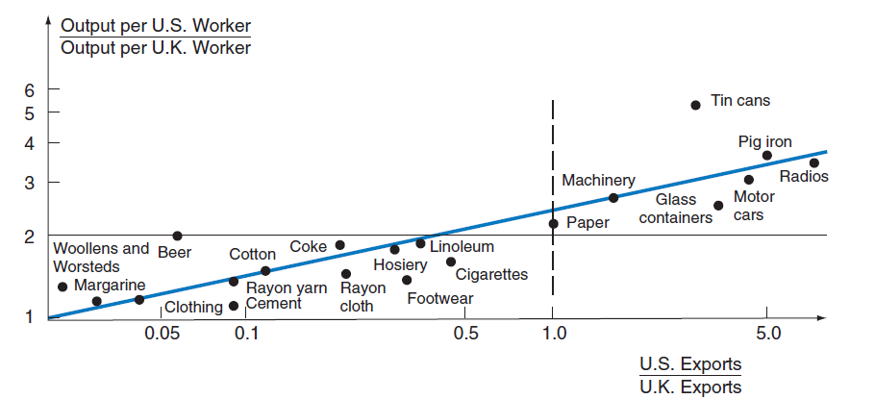
Empirical Tests of the Ricardian Model

Slide 33
Relative Labor Productivities and Comparative Advantage—United States and United Kingdom
The figure shows a positive relationship between labor productivity and export shares for 20 industries in the United States and the United Kingdom, thus confirming the Ricardian trade model.

Slide 34
Empirical Tests of the Ricardian Model
The points in the figure exhibit a clear positive relationship (shown by the colored line) between labor productivity and exports.
That is, those industries where the productivity of labor is relatively higher in the United States than in the United Kingdom are the industries with the higher ratios of U.S. to U.K. exports.
This was true for the 20 industries shown in the figure.
The positive relationship between labor productivity and exports for the United States and the United Kingdom was confirmed by subsequent studies by Balassa using 1950 data and Stern using 1950 and 1959 data.
Additional and more recent confirmation of the Ricardian trade model is provided by Golub (see Case Study 2-4).

Slide 35
Empirical Tests of the Ricardian Model
Even though the simple Ricardian trade model has been empirically verified to a large extent, it has a serious shortcoming in that it assumes rather than explains comparative advantage.
That is, Ricardo and classical economists in general provided no explanation for the difference in labor productivity and comparative advantage between nations, and they could not say much about the effect of international trade on the earnings of factors of production.
By providing answers to both of these important questions, the Heckscher-Ohlin model (discussed in Chapter 5) theoretically improves on and extends the Ricardian model

